Slide 1
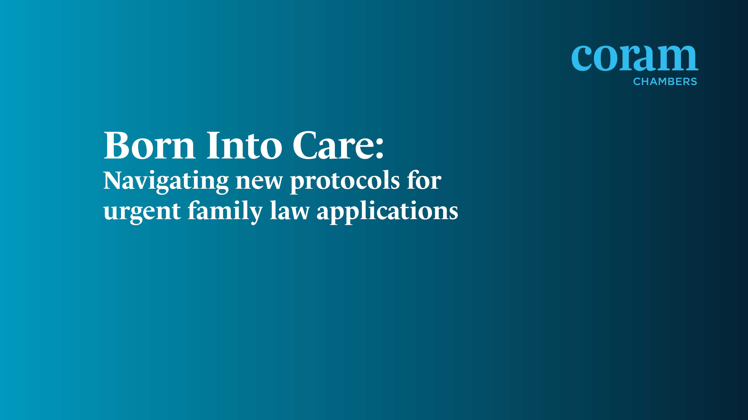
Professor Karen Broadhurst OBE
Centre for Child and Family Justice Research
Lancaster University

Slide 2


A New-born Baby Protocol for England & Wales
A Research Perspective
Coram Chambers 20th May 2026
Professor Karen Broadhurst, OBE.
Centre for Child and Family Justice Research, Lancaster University.

Slide 3

A welcome development
Successive studies in the Born into Care series evidence:
Wide variation in the timing of pre-birth intervention & fragmented services
Practice which is not consistently inclusive or proportionate at birth
Checks and balances too frequently compromised
Major questions regarding full parental participation
Notes:
I want to start by saying – that academic researchers, including my own team and our collaborators, welcome the New-born baby protocol – fantastic development, and it’s great to see a very good fit between the elements of the protocol and research findings… so I want to just start by

Slide 4
Research highlight: same day hearings
100%
The proportion of cases in which the application is issued and a first hearing scheduled on the SAME DAY – has been increasing in England
Approximately 20% of all new-born baby cases were heard the same day in 2022/23
NB: statistics replicated by Nuffield FJO in 2025, do not show any marked changes from the first publication by the Lancaster-Swansea team in 2021
80%
60%
40%
20%
0%
2013/14
2014/15
2015/16
2016/17
2017/18
2018/19
2019/20
2020/21
2021/22
2022/23
Same day
1-2 days
3-6 days
7+ days
Notes:
In Wales – more varied over time
70-80% of hearings involving newborns are held at short notice. Same day hearings about same as England at 20% but a higher proportion of hearings are taking place 3+ days after the birth.

Slide 5
Research highlight: same day hearings
Percentage of proceedings that involve same-day hearings
East Midlands
East of England
London
North East
Considerable regional variation in the use of same day hearings continues.
London and the SE have the lowest proportion at around 10%
The NE has the largest proportion at around 40%
A marked increase in same day hearings in Yorkshire and Humber
50
50
50
50
40
40
40
40
30
30
30
30
20
20
20
20
10
10
10
10
0
0
0
0
2017/18
2017/18
2017/18
2017/18
2016/17
2016/17
2016/17
2016/17
2015/16
2018/19
2021/22
2015/16
2018/19
2021/22
2015/16
2018/19
2021/22
2015/16
2018/19
2021/22
2020/21
2020/21
2020/21
2020/21
2019/20
2022/23
2019/20
2022/23
2019/20
2022/23
2019/20
2022/23
North West
South East
South West
West Midlands
50
50
50
50
40
40
40
40
30
30
30
30
40
20
20
20
20
10
10
10
0
0
0
0
2017/18
2017/18
2017/18
2017/18
2016/17
2016/17
2016/17
2016/17
2015/16
2018/19
2021/22
2015/16
2018/19
2021/22
2015/16
2018/19
2021/22
2015/16
2018/19
2021/22
2020/21
2020/21
2020/21
2020/21
2019/20
2022/23
2019/20
2022/23
2019/20
2022/23
2019/20
2022/23
Yorkshire and
the Humber
Wales
50
50
40
40
30
30
20
20
10
10
0
0
2017/18
2017/18
2016/17
2016/17
2015/16
2018/19
2021/22
2015/16
2018/19
2021/22
2020/21
2020/21
2019/20
2022/23
2019/20
2022/23
Notes:
There has been a lot of innovation in England and Wales to the born into care series, but these statistics indicate that there is some way to go to improve the consistency of practice – glaring differences between London, the SE and NE and Yorkshire and Humber – and these differences persist. The protocol provides, rolled out across the Family Courts, holds out the promise of improving consistency and proportionatlity.

Slide 6

Why are questions of proportionality so critical?
Welsh data linkage studies which linked maternity records to care proceedings for 1000+ mothers and babies
The majority babies in care proceedings were born full-term and healthy based on screening checks at birth (85%)
Pregnancy concealment was rare (6%)
31% were first time mothers
Notes:
Apgar score at birth (below 7 is 3.4%) (sample size is 1,111 cases, care proceedings between 2015-2018)

Slide 7
Why are questions of proportionality so critical?
In a proportion of new-born baby care cases – it is very clear that immediate removal at birth is the RIGHT decision
However – there is an equal if not greater proportion of cases – where it is far less clear:
A. How the parents will respond to the birth of the baby
B. Whether parents can/cannot respond to help and make the changes required (truncated assessment window and anticipatory harm)
C. Assessment is not complete

Slide 8
Consistent Professional Concerns
Extensive in-depth qualitative research by academics at the Universities of Lancaster and Oxford found -
Consistent professional concern that essential checks and balances are compromised – in particular, independent scrutiny by Cafcass - meaning poor decision-making or incomplete pre-birth assessment can go unchallenged
Consistent professional concern across regions of England and Wales, about the reliability of hasty decision-making for infants

Slide 9

Specific professional challenges of proceedings at birth
Assessment is artificially constrained by the timeline of pregnancy
The unborn child is often less of a priority in very busy social work teams
It is not possible to know definitively when the baby will be born
It is not possible to know definitely – how the parents will respond to the birth of the new baby
Assessment is typically based on ‘anticipating’ harm

Slide 10

What further system level changes are needed?
Should mother and baby co-placement be the default?
Would mitigate some of the considerable challenges of trying to make a robust decision at birth
Limited – but important evidence that London statistics are in part, explained by co-placement of mother and baby - with high success rates (at short-term follow up)
Would bring practice more in line with other areas of legislation which protect an acute post-partum period (6 weeks, WHO)
If separation is deemed necessary – gives time for proper care and support for all parties
(NB – local authorities will have to pay for foster care for babies…a proportion of cases would not come to court…so a cost argument must take this into account)

Slide 11
Lessons from overseas…Norway
Newborns are a discrete category in child welfare legislation which governs emergency removals and care proceedings (Child Welfare Act, 2021).
CWS must assess the newborn’s need for closeness to the parents immediately after birth
The Tribunal – is more cautious in these cases, expecting a higher standard of evidence – because parents’ ability to care for the baby has not been tested.

Slide 12
Lessons from overseas… the US
“Reasonable Efforts”
Have reasonable efforts been made to prevent the need for separation at birth?

Slide 13
Lessons from overseas
New Zealand
Indigenous family-led design and delivery – strong emphasis on peer/community advocacy and support for kinship placements
Changes to policy and practice centrally(govt) mandated
Major drop in new-born removals from indigenous communities

Slide 14
Book Launch: Online, 10th of June 5pm – 6.30pm
Publication date 26th of May (open access e-book)
Buy the book at 50% discount if you attend the launch!
Register here:
https://www.lancaster.ac.uk/centre-for-child-and-family-justice-research/events/centre-for-child-and-family-justice-research-book-launch-international-perspectives-on-the-removal-of-babies-at-birth/
Any problems with registering – contact myself or Jodi Lo - w.l.lo@Lancaster.ac.uk

Slide 15
References (free open access)
Karen Broadhurst, Claire Mason, Harriet Ward (2022), Urgent Care Proceedings for New-born Babies in England and Wales – Time for a Fundamental Review, International Journal of Law, Policy and the Family, Volume 36, Issue 1, ebac008, https://doi.org/10.1093/lawfam/ebac008
Pattinson, R. et al. (2021) Newborn babies in urgent care proceedings at birth. London: Nuffield Family Justice Observatory. https://www.nuffieldfjo.org.uk/resource/newborn-babies-urgent-care-proceedings

